Slide 1
Computational Photography
Independent Study Presentation 1:
Introduction to Computational Photography and Optics
Presented By:
Apoorva Srivastava
MS by Research, IIIT Hyderabad
2019702014
Guide and Advisor:
Dr. Anoop Namboodiri

Slide 2
Overview of the
Presentation
Introduction to Computational Photography
Components of Computational Photography
Stages of Computational Photography
Understanding Light
Wave and Particle Nature of light
Defining Optical System with Rays
Measuring the light rays-Radiometry and Photometry
Understanding Lenses and Digital cameras*
Optics of Lens and Ray bending
Interaction of Light and Matter
Conclusion
References
Future of Computational Photgraphy
Lens and Digital Camera Parameters and Trade-Offs

Slide 3
Introduction to
Computational Photography

Slide 4
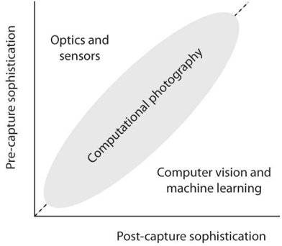
Definition and Origin of Computational Photography
Hence, Computational Photography enables us to capture what we want to capture rather than what we can capture!!!
Computational Photography captures a machine-readable representation of the physical world, allowing us to hyper-realistically synthesize the essence of our visual experience.​
Image Credit: Raskar Tumblin Computational Photography

Slide 5
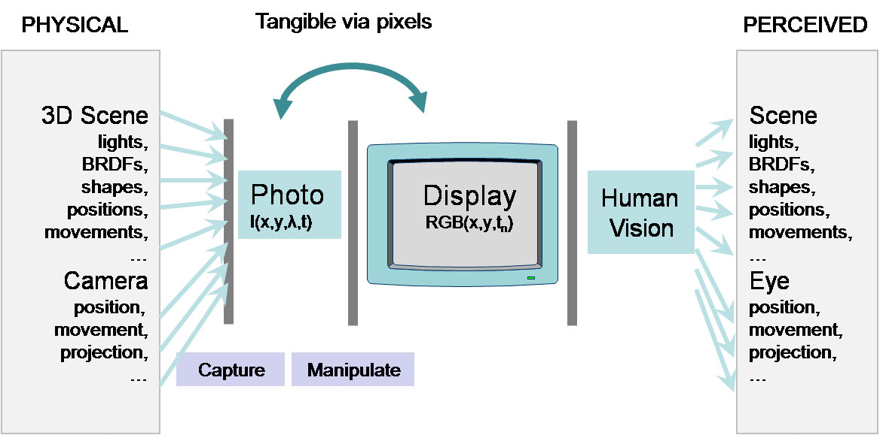
Digital Photography
Only by the
humans
Hence, Computational Photography enables us to capture what we want to capture rather than what we can capture!!!
Image Credit: Raskar Tumblin Computational Photography

Slide 6
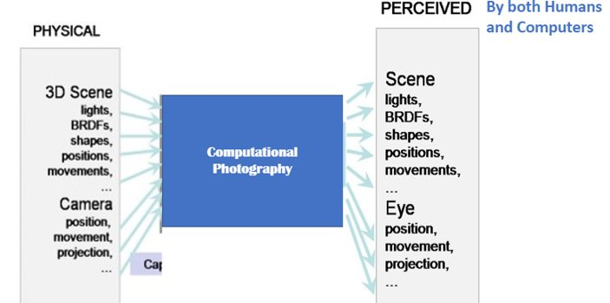
Computational Photography
Hence, Computational Photography enables us to capture what we want to capture rather than what we can capture!!!

Slide 7
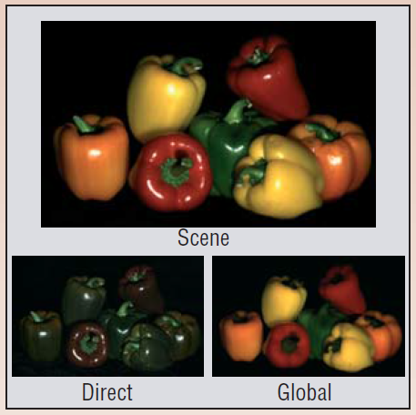
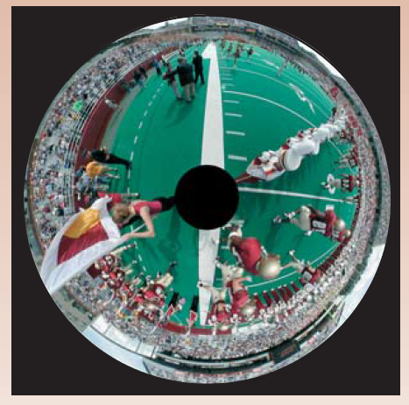
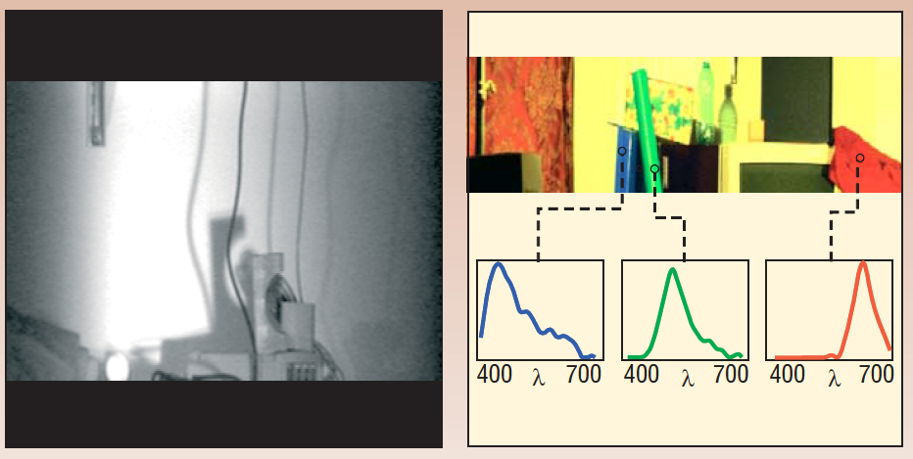
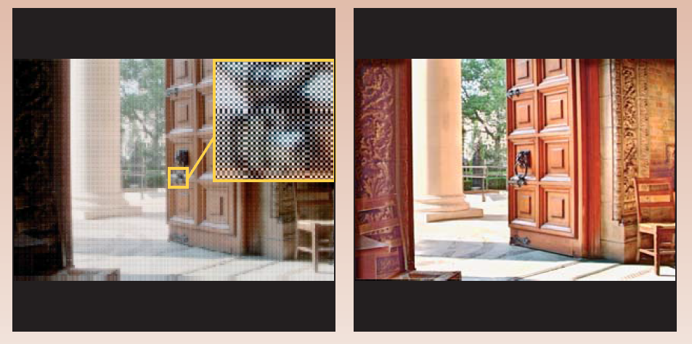
What Computational Photography Enables:
To Construct New Visual Information e.g. 360 degree view from a single point and single camera
To Measure already present Visual Information e.g. Observing multiple EM frequencies present in the scene
To Manipulate Visual Information e.g. Relighting the images and Creating the new viewpoints
To Create New Visual Information from a given scene e.g. Creating Global and Direct Component of a scene
Image Credit: Computational Cameras, Shree K Nayar

Slide 8
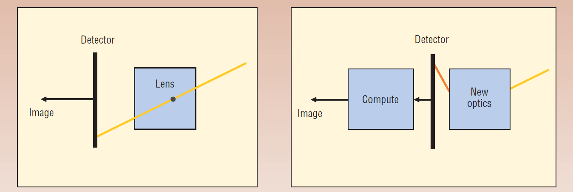
How Computational Photography Does so?
It replaces the
Lens with Generalized Optics
Sensor with Generalized sensor
Natural Light and Flashlight with Programmable Illumination
Incorporates Processing Computational Algorithm before giving out the final Image.
Digital Photography
Computational Photography
Image Credit: Computational Cameras, Shree K Nayar

Slide 9
Components of Computational Photography
Rays are the fundamental Element : Traces all possible ways energy can be transferred by rays from scene to sensor to eyes
Generalized Optics: Manipulates incoming 4D Light Field into new 4D Light Field going to the sensors
Generalized Sensors: Un-Conventional sensors to capture new scene properties not possible to be captured by traditional sensors
Computational
Imaging
Computational Illumination : Replacing the simple flash with customized light to discover the unseen scene elements
Generallized Processing and reconstruction: Appplication of ML& CV methods to get the desired results and express image semantics

Slide 10
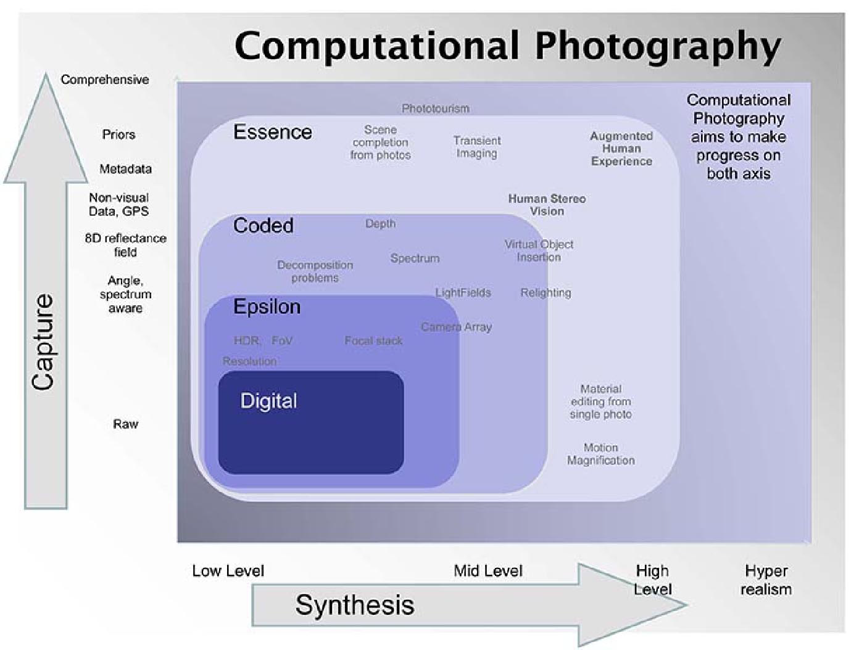
Stages of Computational Photography
Digital Photography
Epsilon Photography
Essence Photography
Coded Photography
Image Credit: Raskar Tumblin Computational Photography

Slide 11
Film-like Digital Photography
Basic Structure and Components
Component | Purpose
Camera Obscura Structure | To admit light in a dark box and forming image on a plane inside the box
Lens | To control aperture ,focus distance and focal length
Sensor | To control light sensitivity, latitude and color sensing
Camera Box | To control moment of exposure, location and orientation
Auxiliary Lighting | To control position, intensity and timing of illumination

Slide 12
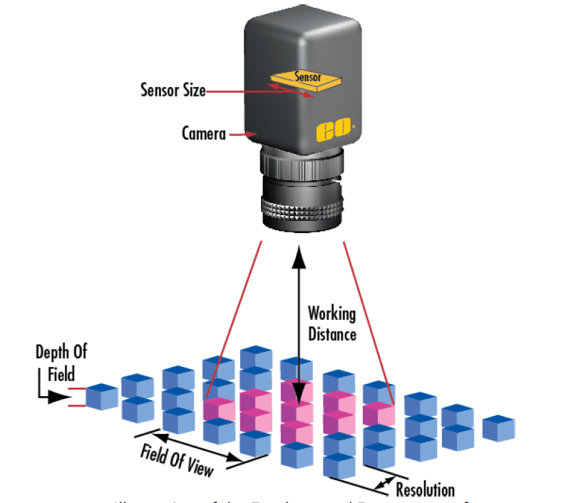
Film-like Digital Photography
Parameters to be decided while clicking a Digital Photograph
Wavelength Resolution
Field of View
Exposure & Dynamic Range
Depth of Field
Spatial Resolution
Temporal Resolution

Slide 13
Digital Camera and Trade-Offs
Larger the focal length larger the PMAG but smaller the field of view
Shorter the focal length larger the field of view but more distortions and cost of lens
Larger the Focal Length and aperture more is the light admitted for dimly lit scene but smaller the FOV
Increasing Depth of Focus requires smaller aperture hence increased exposure time and higher sensor sensitivity leading to higher noise
Higher the Spatial resolution smaller the pixel size larger the data storage requirements
Exposure time too large moving objects appear blurred and when too short then less amount of light gets captured
Higher the spatial resolution poorer is Depth of Focus
Larger lens apertures gather more light, but reduce the depth of focus in the image
Larger the focal length larger the PMAG but smaller the field of view
Shorter the focal length larger the field of view but more distortions and cost of lens
Larger the Focal Length and aperture more is the light admitted for dimly lit scene but smaller the FOV
Increasing Depth of Focus requires smaller aperture hence increased exposure time and higher sensor sensitivity leading to higher noise
Higher the Spatial resolution smaller the pixel size larger the data storage requirements
Exposure time too large moving objects appear blurred and when too short then less amount of light gets captured
Higher the spatial resolution poorer is Depth of Focus
Larger lens apertures gather more light, but reduce the depth of focus in the image
A longer exposure time, additional scene lighting (such as flash), or greater sensitivity makes brighter pictures. But a longer exposure time can increase blur, additional lighting can disrupt scene appearance, and greater sensitivity results in increased noise.
A longer exposure time, additional scene lighting, or greater sensitivity makes brighter pictures. But a longer exposure time can increase blur, additional lighting can disrupt scene appearance, and greater sensitivity results in increased noise.

Slide 14
Epsilon Photography
It improves a given image by recording multiple images each varying one or more camera parameter by some small amount epsilon.
Each epsilon setting allows partial information of the scene which is combined to give a better scene representation.
This stage involves low level processing of pixels and localized scene features.
Goal: To enhance the performance of traditional parameters of the camera and go beyond their mutual trade-offs

Slide 15
How Epsilon Photography improves the Digital Camera Parameters
Wavelength Resolution
Field of View
Depth of Field
Spatial Resolution
Temporal Resolution
It can be enhanced by creating image panorama by stitching images of overlapping regions
Can be improved by Exposure bracketting and calculating normalized pixel value
Exposure & Dynamic Range
Can be enhanced by combining images with different plane of focus
Higher Spatial resolution can be obtained tiling multiple cameras and assembling spatially varying mosaic form
High speed imaging is attained by staggering the exposure time of multiple low frame rate camera
Expands wavelength resolution by successively changing the color filter in front of the camera during exposure

Slide 16
Coded Photography
Coded Photography tries to go beyond the Digital Camera capabilities
Unlike Epsilon Photography Coded Photography captures mid-level cues like shape,boundary,depth etc along with pixels
Goal: To estimate scene properties that are not directly visible and are critical for post capture manipulation and synthesis
Coded Photography is an out of box photgraphic method in which individual ray sample or data set may not be comprehensible without further re-binning decoding and reconstruction

Slide 17
Some Examples
of
Coded Photography
Decomposition of Scene in meaningful components such as Global Direct Component ,Foreground and background Components etc.
Coded Exposure Technique to capture fast moving object which otherwise appears blurry
Gradient Camera for higher Dynamic Range
Confocal Synthetic Aperture to see through murky water
Coded Aperture Technique to re-focus the out of focus region by preserving the high spatial frequencies of light
Using Multiple flashes to distinguish b/w geometric and reflectance boundaries of the object
Techniques to recover the glare by capturing selected ray through a calibrated grid

Slide 18
Essence Photography
In this photography measurements goes beyond radiometric quantities of the scene.
Goal: To capture the essence of a scene and scruitinize its perceptually critical components.
A camera equipped with essence photography may-
Measure Geographical location coordinates of the scene
Identifies Scene Contents
Recognizes Gestures
Can perform non-photorealistic synthesis like motion exaggeration, beautification of photographs etc.

Slide 19
Hence, Computational Photography enables us to capture what we want to capture rather than what we can capture!!!

Slide 20
Understanding Light

Slide 21
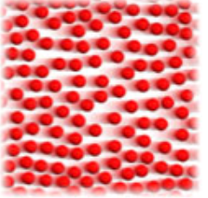

Scientific Theories about the Nature of the Light
Two Conflicting Approaches:
Light is made up of Particles Light is made up of Waves
vs

Slide 22
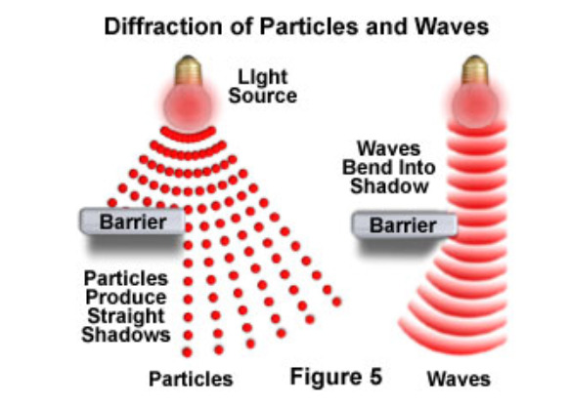
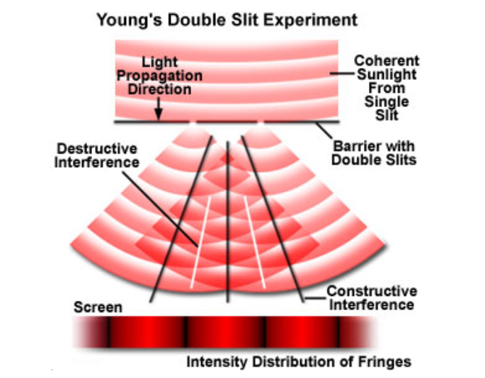
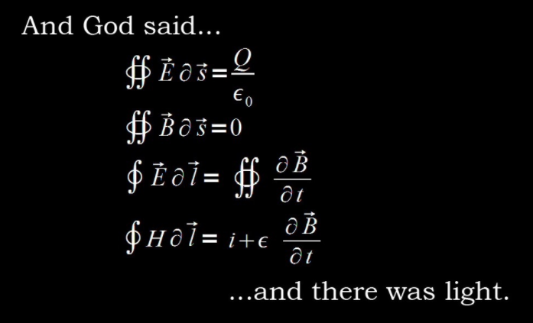
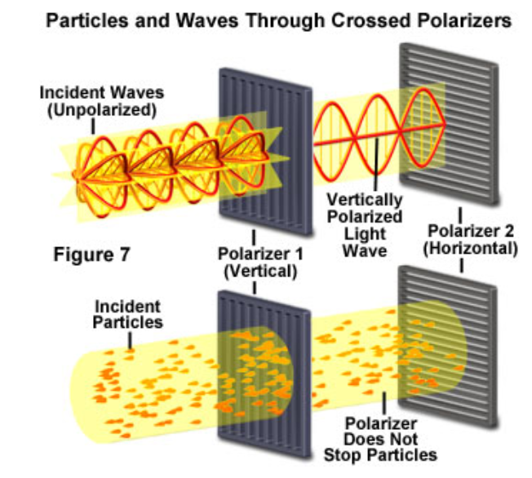
Phenomena and Experiments Demonstrating Wave Nature of Light
Diffraction of Light
Interference of Light as Waves
Maxwell's Equation for Wave Propagation Polarizers filtering the Light

Slide 23
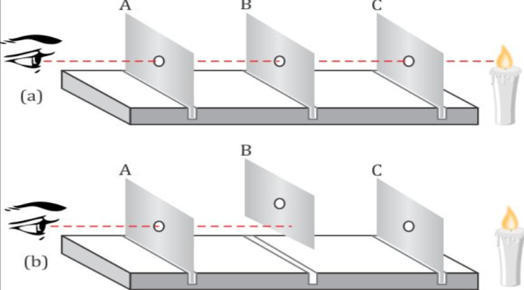
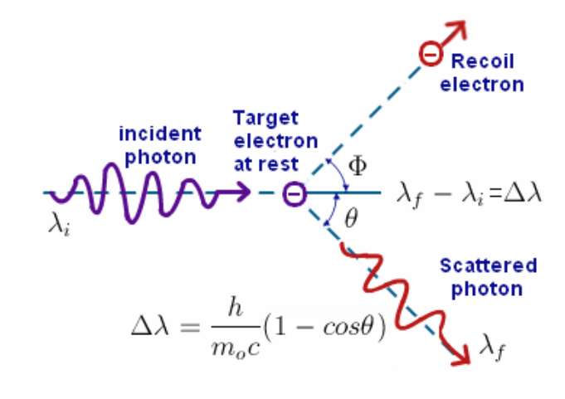
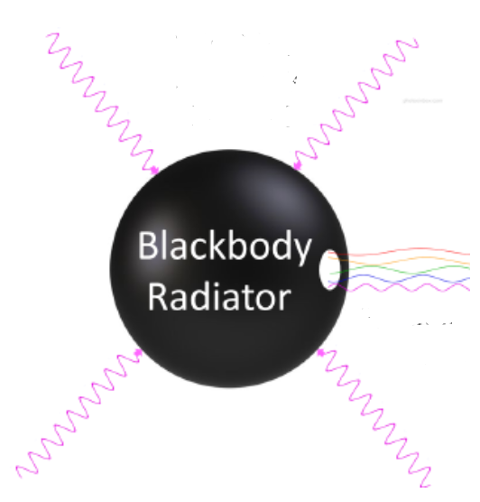
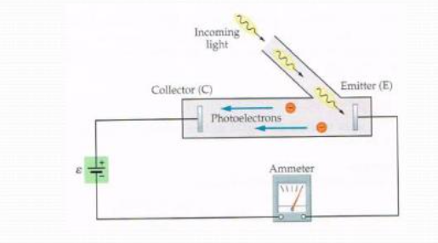
Phenomena and Experiments Demonstrating Particle Nature of Light
Light travels in a straight-line path
Compton Scattering
Black body radiation explanation Photoelectric Effect

Slide 24
Conclusions about the Nature of the Light
Light exhibits wave-particle duality
Light behaves as a wave at macroscopic scales, but it behaves as a particle at atomic scales.
Maxwell's equations are sufficient when there are many photons, and quantum theory is necessary when there are only a few photons.
Light propagates as a wave, but it interacts with matter as a particle when the matter is of comparable size as the wavelegth of the wave.

Slide 25
Defining Optical System with Rays

Slide 26
Understanding the Ray Space
What is a Ray intuitively?
It is a 2-way tracing through space which a single photon might leave behind as it propagates
It is a simplified model of wave nature,representing wave as a straight line
Formal Definition of Ray Space
We define Ray Space/Plenoptic 4D position-angle function to identify every ray in 3D space
2 dimensions for position on the plane it is being imaged and 2 dimensions for the incidence angle.
Why Rays?
Helps explore complex Optical System locally
Decomposition of every optical operation as a ray bending event
Ray paths are exactly reversible, so ray tracing helps to characterize any physical space.
Other dimensions such as polarization and wavelngth etc. Characterizing the ray can be added

Slide 27
Challenges and Solution for Ray based measurements
What is the basic challenge in measuring the rays?
One single ray doesn't exist in isolation and carries non-measurable amount of Light.
Its angular extent is zero and it comes from a single point on source with zero area.
Solution
We can measure the strength of the Light carried by bundle of rays instead of dealing with single ray
Strength of Light can be measured in terms of Power and Energy leaving the source and reaching the destination in terms of rays
This field which measures the Light Rays are referred as Radiometry and Photometry.

Slide 28
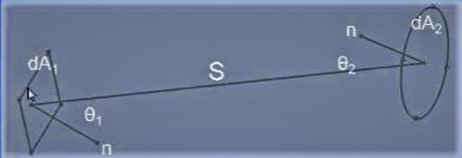
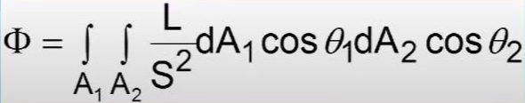
Radiometry
Radiometry is the process of measuring the EM radiation which includes visible range also
While
Photometry is the process of measuring the visible light radiations as experienced by human eyes. It's a normalized form of Radiometry for human vision.
What we want to measure is How much energy from source area dA1 was captured by destination area dA2 per second
Fundamental Law of Radiative Transfer

Slide 29
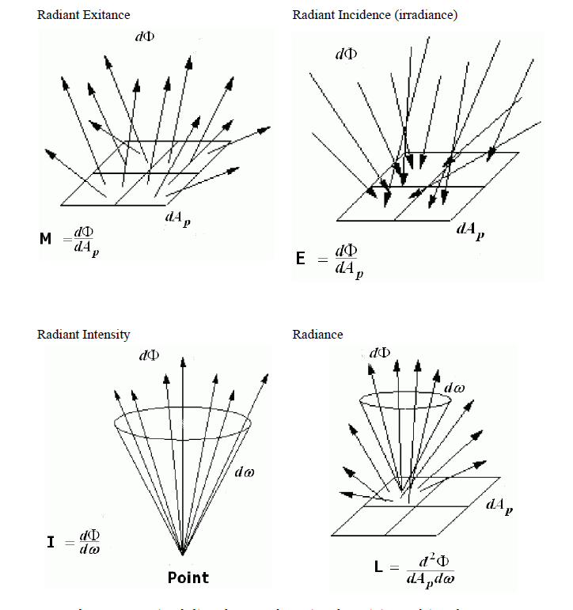
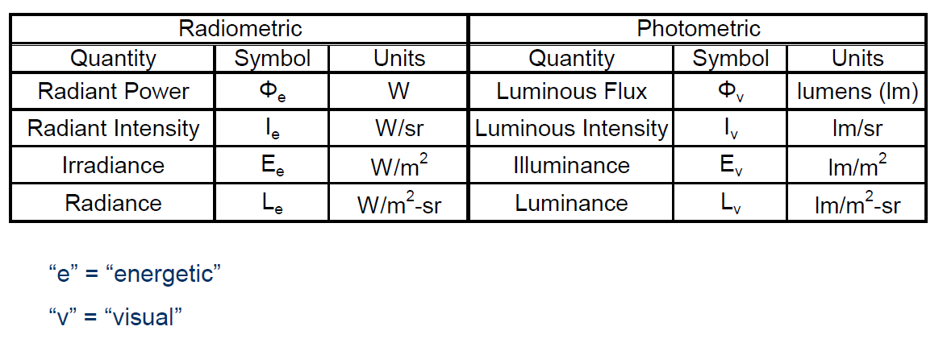
Parameters of Radiometry
Image Credit: Breault Research Organization

Slide 30
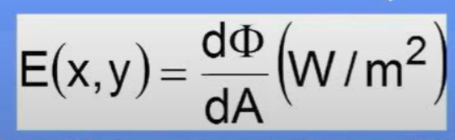
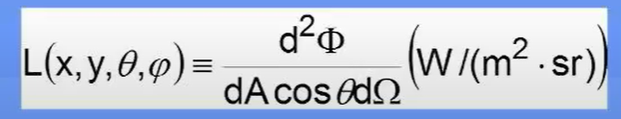
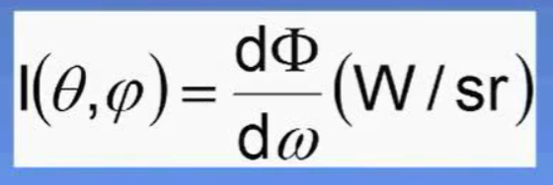
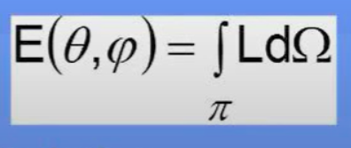

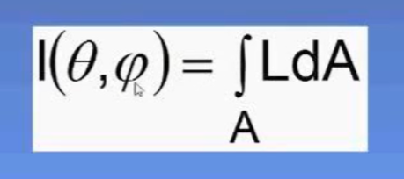
Parameters of Radiometry
Irradiance Radiance Radiant Intensity
Inter-Dependence among the parameters

Slide 31
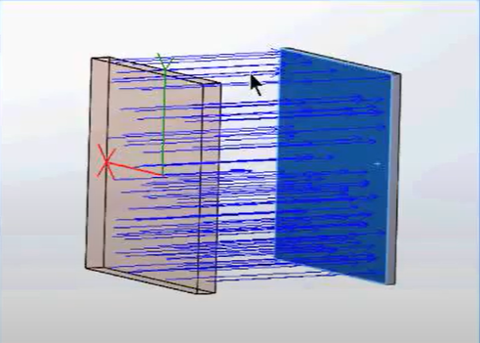
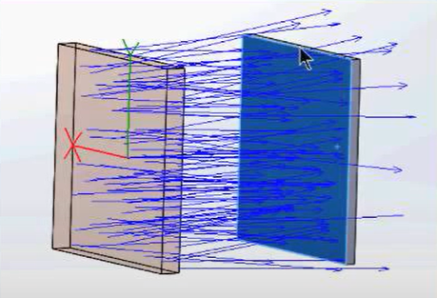
Significance of Parameters of Radiometry
By measuring the power of ray bundles we want to measure and characterize rays which can’t be measured in isolation
Radiance is power corresponding to a single ray; this is what our eyes can measure. Radiance identifies a single ray completely as it remains constant throughout the propagation in a lossless medium.
Irradiance basically localizes the position of rays on the incidence plane by measuring the power transferred to unit area
Radiant intensity localizes the incidence angle of the rays by measuring the power transferred to unit solid angles
Irradiance and Radiant intensity talk about the power distribution on the destination

Slide 32
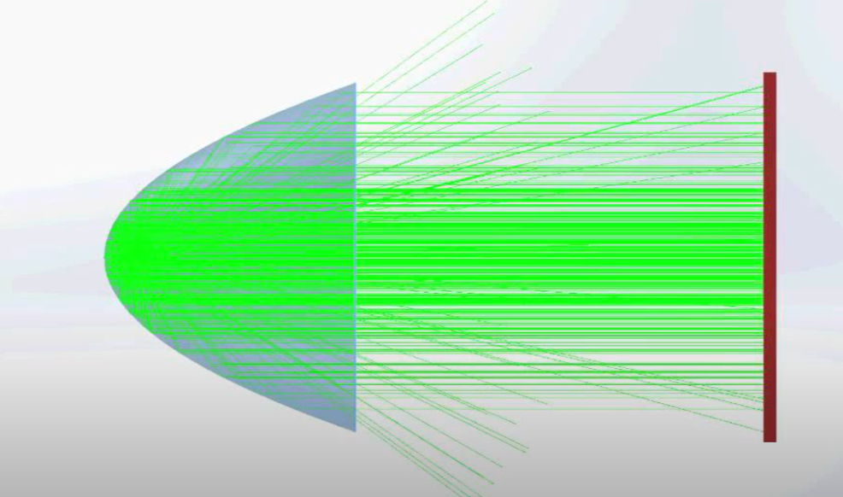
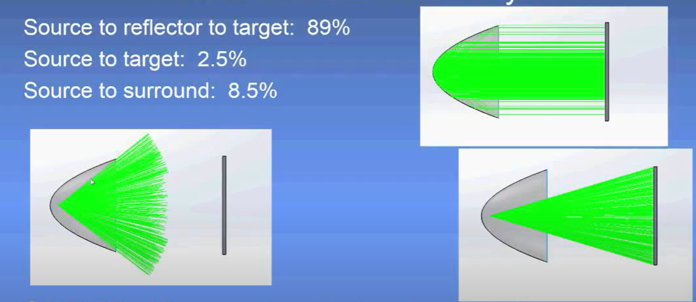
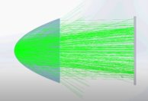
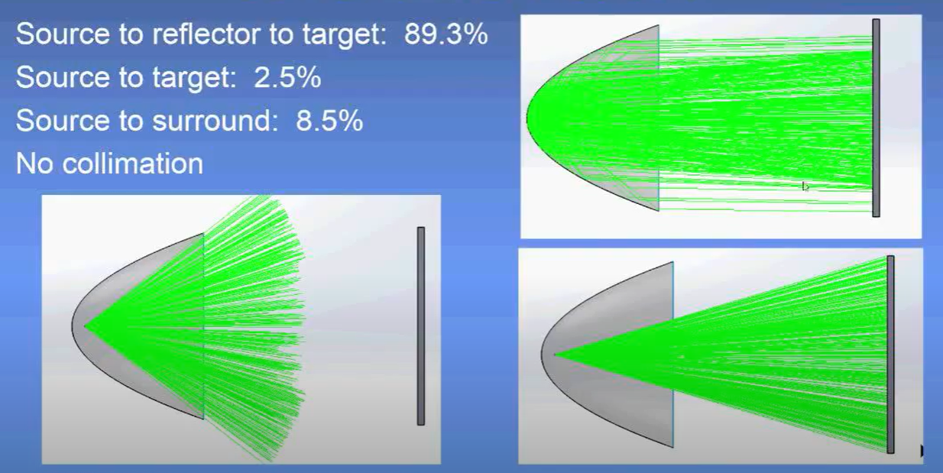
Understanding the Parameters with a Ray Tracing simulation result
Case1
Case2
Image Credit: Breault Research Organization

Slide 33
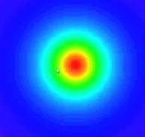
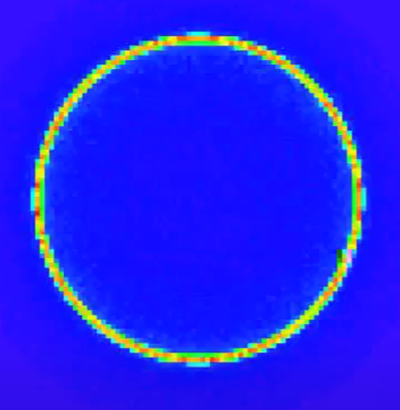

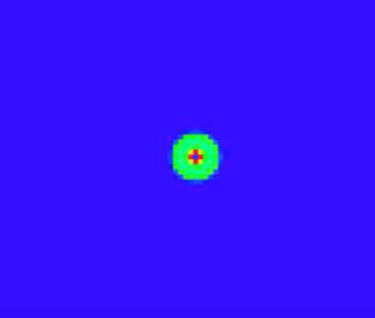
Understanding the Parameters with a Ray Tracing simulation result
Irradiance Pattern for Case1
Irradiance Pattern for Case2
Radiant Intensity angle variation for Case1 Radiant Intensity angle variation for Case2
Image Credit: Breault Research Organization

Slide 34
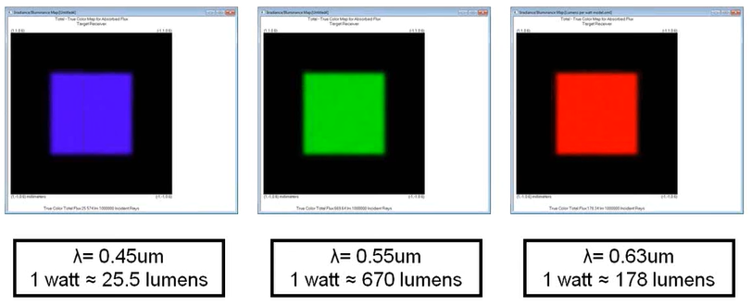
Why do we need Photometry if we already have Radiometry
Image Credit: Lambda Research Corporation

Slide 35
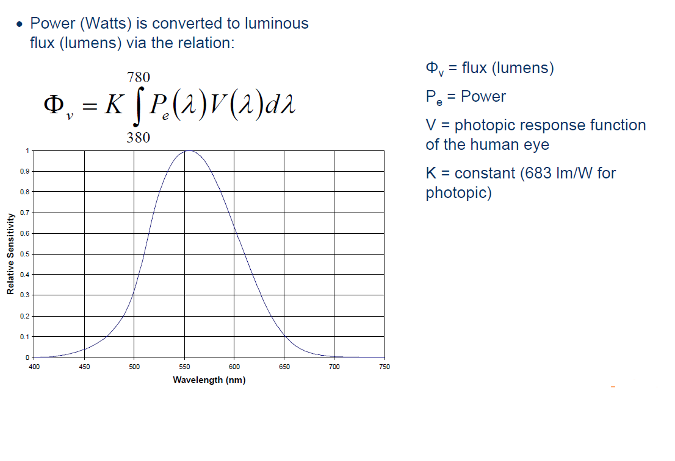
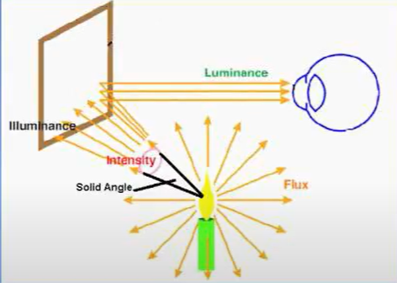
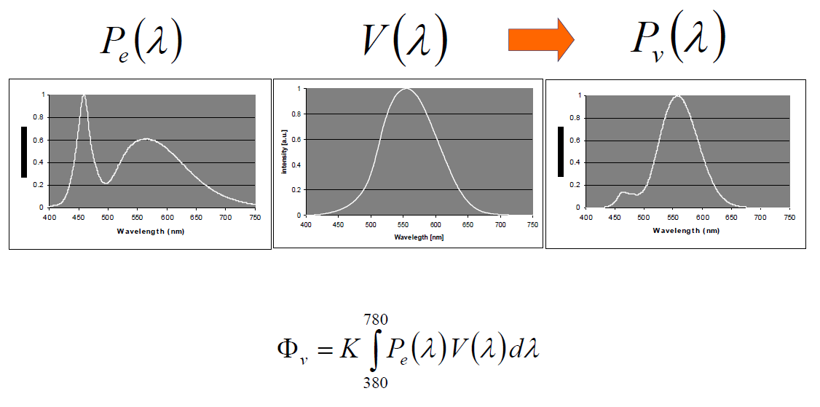
Conversion from Radiometric to Photometric Quantities
Image Credit: Osram Opto-Semiconductors

Slide 36
Photopic response of Light is the plot between Spectral Radiant Flux and the wavelength
There is no direct correlation between Radiant flux and Luminous flux
Spectral Efficacy is a measure of how much lumens are obtained per watt of Radiant Flux
1 Watt converts to 683 lumens at 555 nm wavelength.
Even if a white light source has Radiant spectral exactly same as the photopic curve the maximum efficacy is 240 lumens/watt
The maximum Luminous efficacy of 100% is obtained as 683 lumens/watt at 555 nm
Spectral Distribution and Luminous Efficacy

Slide 37
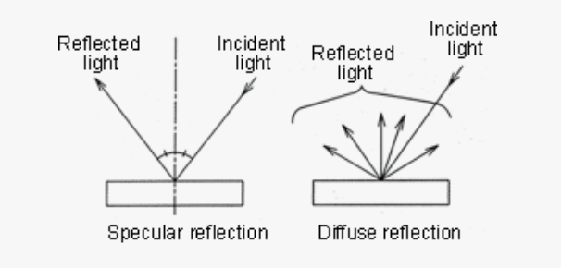
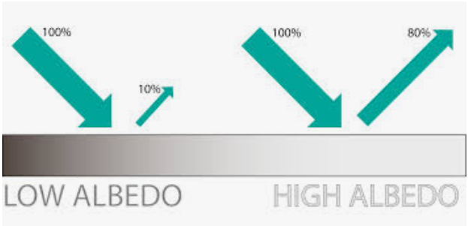
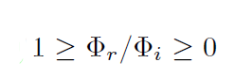
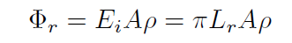
Interaction of Light and Materials
Albedo
The ratio of amount of radiant flux leaving a surface to the amount of radiant flux incident on the surface.
For perfectly diffuse surfaces

Slide 38

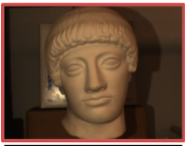
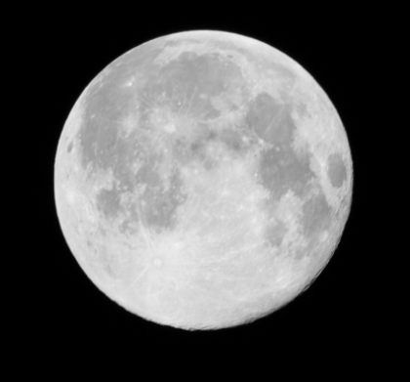

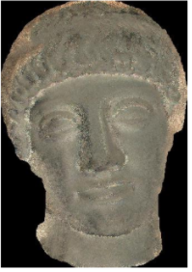
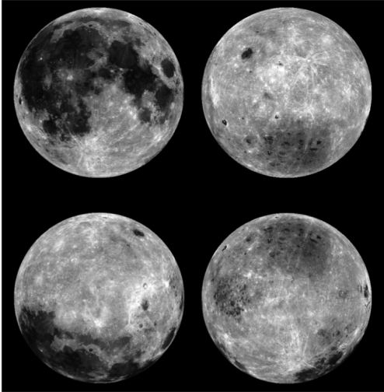
Interaction of Light and Materials
Example of Albedo Map
Objects and their corresponding albedos

Slide 39
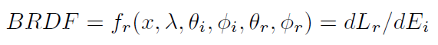
Interaction of Light and Materials
BRDF
The Bidirectional Reflectance Distribution Function (BRDF), measured at a single point x on a surface, is the ratio of outgoing radiance Li to incoming irradiance Ei, where irradiance is received from just one direction.
The reflectance of the material varies with the illumination direction and the viewing direction. BRDF, which describes what portion of the incident light from one direction will leave in another given direction.

Slide 40
Interaction of Light and Materials
Properties of BRDF
1
2
3
4
Incoming and outgoing directions cover all directions both above and below the surface, thus enabling BRDF to describe refection and transmission combined.
The BRDF function is symmetric for all materials. Its value is identical if we swap the incoming and outgoing directions. This is known as Helmholtz Reciprocity.
It is not simply the ratio of incoming and outgoing radiance for two chosen rays, a ratio that would always fall between 0 and 1. It is the ratio of the outgoing ray's radiance Lr to the irradiance E from only one direction.
Thus a perfect difuse reflector has a BRDF value of 1 and not the value of 1/π you might initially expect.
The 5 input dimensions of BRDF namely the 4 angles(incoming,outgoing) and wavelength makes it tidious to calculate.
Though BRDF databases for different surfaces are present,usually we resort for parameterized BRDF models for the surface.

Slide 41

Interaction of Light and Materials
BRDF based models fail to model the surfaces which are translucent like human skin, marble, milk etc.
BRDF assumes every material to be either opaque or transparent.
BRDF assumes that ray changes occur only at surfaces not within the surface.
BSSRDF is Bi-Directional Sub-Surface Reflectance Distribution Function
That is, it does not acknowledge sub-surface scattering.
BSSRDF is also calculated using predefined parametric surface models
BSSRDF

Slide 42
Using Radiometry and Photometry any source of light and its incidence on a surface can be measured.
With the help of Albedo, BRDF and BSSRDF any material can be characterized for its interaction with light rays.
Hence, we can define an optical system with RAYS

Slide 43
Understanding Lenses and Digital Cameras

Slide 44
Rays Define a vast set of Lenses in 9D space with each point defining a unique lens.
Any ray-bending device qualifies as a lens, including mirrors, running water, and atmospheric anomalies.
For imaging a lens is any device that bends incoming rays into useful patterns of outgoing rays.
However, meaningful lenses for focused images fall on a 3D manifold of 9D space
Parameters we can control in Lens Design are
Refractive Index
Lens Shape
However,assessment of Lens Error is not done using 9D function calculation rather by assessing the images they form
What are Lenses

Slide 45


Ray Bending
4 Laws of Ray bending in Optics
1. Light travels in a straight line path in a material of constant refractive index
2. The angle of incidence is same as the angle of reflection
3.The ray bending occurs when light propagates from one medium to other according to following equation
4. Rays and Refraction Laws are only valid for optical systems where diffraction doesn't occur. Diffraction odifies the path of the rays that pass through openings of size< 10*lambda

Slide 46

Ray Bending for Image formation
Through the ray bundles some finite fraction of Radiant exitance M from scene point P becomes the radiance E on sensor
However, every time calculating the E is cumbersome, so we model lenses as thin Lens for the practical purposes

Slide 47



Ideal Thin Lens parameters
We have 3 parameters to choose from for defining Ideal Lens completely
Focal Length
Aperture Diameter
Lens Speed or f-number

Slide 48
Digital Camera Parameters
PMAG
Field of View
Working Distance
Depth of Field
Resolution
Sensor Size
PMAG = Sensor Size [mm] / Field of View[mm]
Image Credit: Edmund Optics

Slide 49


Focal Length and Field of View
Image Credit: Edmund Optics

Slide 50


Resolution
Image Credit: Edmund Optics

Slide 51


Contrast
Image Credit: Edmund Optics

Slide 52

Depth of Field

Slide 53
Digital Camera and Thin Less Trade-Offs
Larger the focal length larger the PMAG but smaller the field of view
Shorter the focal length larger the field of view but more distortions and cost of lens
Larger the Focal Length and aperture more is the light admitted for dimly lit scene but smaller the FOV
Increasing Depth of Focus requires smaller aperture hence increased exposure time and higher sensor sensitivity leading to higher noise
Higher the Spatial resolution smaller the pixel size larger the data storage requirements
Exposure time too large moving objects appear blurred and when too short then less amount of light gets captured
Higher the spatial resolution poorer is Depth of Focus
Larger lens apertures gather more light, but reduce the depth of focus in the image
Larger the focal length larger the PMAG but smaller the field of view
Shorter the focal length larger the field of view but more distortions and cost of lens
Larger the Focal Length and aperture more is the light admitted for dimly lit scene but smaller the FOV
Increasing Depth of Focus requires smaller aperture hence increased exposure time and higher sensor sensitivity leading to higher noise
Higher the Spatial resolution smaller the pixel size larger the data storage requirements
Exposure time too large moving objects appear blurred and when too short then less amount of light gets captured
Higher the spatial resolution poorer is Depth of Focus
Larger lens apertures gather more light, but reduce the depth of focus in the image
A longer exposure time, additional scene lighting (such as flash), or greater sensitivity makes brighter pictures. But a longer exposure time can increase blur, additional lighting can disrupt scene appearance, and greater sensitivity results in increased noise.
A longer exposure time, additional scene lighting, or greater sensitivity makes brighter pictures. But a longer exposure time can increase blur, additional lighting can disrupt scene appearance, and greater sensitivity results in increased noise.

Slide 54
Conclusion

Slide 55
Future Impact of Computational Photography
Still many unanswered questions remain in-front of Computational Photography few of them are-
What will the future of photography look like?
What will a camera look like in ten years? In twenty years? In fifty years?
How will powerful new movie-making capabilities change the nature of photography?
Will photography as we know it disappear into a soup of unlimited media possibilities?
How will online photo collections transform visual social computing?
How will a billion portable networked cameras change the social culture?
But Overall,
Computational photography, in which photographs of the future will be computed rather than recorded, has already started to change the work-flow of imaging and give us new and expanded opportunities for seeing.

Slide 56
References
Computational Photography by Raskar Tumblin
Computational Cameras: Redefining the Image By Shree K. Nayar
https://www.edmundoptics.com/knowledge-center
https://www.youtube.com/watch?v=G3PeDWVmlEc&list=PLhjuzo9ZFB2klp0S8IVrKwdVT13aBTI0q&index=18
https://www.khanacademy.org/science/physics/geometric-optics/lenses/v/diopters-aberration-and-the-human-eye?modal=1
https://www.youtube.com/watch?v=Koq19e4xVgg&list=PLjRBT0-8H-NHkA7JxZ4b4o5WDgFcbghOd&index=5
https://www.breault.com/bro-products/apex

Slide 57
Thank You!!!

